Slide 1
Chapter - 4
Operations & Transactions

Slide 2



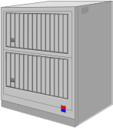

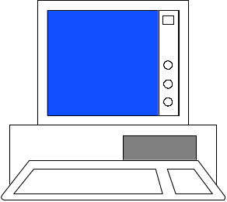
Transactions
Branches / stores
Banks
Financial Institutions
Central Database
EDI/XML/WWW
Online/offline applications
Applications
Web services / Extranets
Suppliers
Point of Sale
Internal users
Collecting transaction data at the point of sale ensures accurate data, speeds transactions, and provides up-to-the-minute data to upper levels of MIS.

Slide 3






Production Data & Process Control
Production machinery & equipment ( on-line, off-line)
Control settings
and commands
Data may be collected on-line or via media
Production data:
Quantity
Quality
Time
Machine status
Control/Surveillance/Audit/Monitoring
Terminal

Slide 4
Electronic Data Interchange
Generally speaking, EDI is considered to be a technical representation of a business conversation between two entities, either internal or external.
The EDI (Electronic Data Interchange) standards were designed to be independent of communication and software technologies.
EDI can be transmitted using any methodology agreed to by the sender and recipient. This includes a variety of technologies, including asynchronous modem,FTP, Email, HTTP, MQ, etc.

Slide 5


EDI: Proprietary
Customer 1
Firms must support multiple data formats and sometimes different computers for each contact.
Queries &
Orders
Order
Database
& Accounts
Supplier
Invoices &
confirmation
Production
Database
& Accounts
Customer 2

Slide 6



EDI: Standards
Route
Messages
Customer 1
Order
Database
& Accounts
EDI consolidator
Messages
to/from
any customer
Production
Database
& Accounts
Convert to
Standard
Customer 2
Supplier

Slide 7
Partial List of ANSI X12 Segments
104 - Air Shipment Information
110 - Air Freight Details and Invoice
125 - Multilevel Railcar Load Details
126 - Vehicle Application Advice
127 - Vehicle Buying Order
128 - Dealer Information
129 - Vehicle Carrier Rate Update
130 - Student Educational Record (Transcript)
140 - Product Registration

Slide 8
EDI On The Internet
Advantages
  Low cost.
  Anyone can connect.
  Worldwide reach.
  Many tools and standards.
  Designed to be robust, minimizes impact of network failures.
Disadvantages
  No service guarantee.
    Delays might be unacceptable.
    Questionable reliability.
  Security is challenging.

Slide 9
Transaction Objects : trade data
Example transaction attributes
  Date & time
  Price
  Quantity – volume
  Value ( price * quantity)
  Item Number
  Buyer
  Seller
Transactions
Items
Date & Time
Value
Item
Buyer
Seller
Item_Id
Description
Location
. . .
Buyers
Buyer_Id
Address
Phone
Sellers
Seller_Id
Address
Phone

Slide 10



Transaction Risks for Payment
1. Receive payment.
2. Legal payment.
3. Customer not reject sale.
4. Government not invalidate sale.
Credit card company accepts risks for a fee.
payment
Vendor
products or services
1. Transaction record.
2. Tax records.
3. Identify fraud.
4. Track money for other cases
Customer
1. Receive product.
2. Charged only as agreed.
3. Legal transaction.
Government

Slide 11
E-Commerce Risk Mitigation
It is critical that vendors protect their databases.
Consumer is protected by credit card company.
Encrypt(Database)
Encryption protects transmission of data and verifies identity of vendor.
Vendor
Encrypt(credit card data)
Verify vendor identity.
products or services
Vendor is not protected by credit card and has only weak methods to verify customer identity.
(No signature, id, face, etc.)
Customer

Slide 12
Shopping on the Internet
Advantages
  Search and compare.
  More tailored information.
  Wider selection.
  More competition.
  Speed: especially if you can download the product.
  Comparison databases: What did others buy?
Disadvantages
  Availability: requires a computer and an ISP.
  Slow speed limits graphics and video.
  Limited portability
  Trust: vendors and consumers.
  Taxation.

Slide 13
Electronic Commerce
Pre-Purchase activities (non-interactive or interactive)
    Promotion.
    Product specifications.
    Pictures.
    Schematics.
    Pricing.
    FAQs.
  Interactive sites.
    Configuration.
    Compatibility.
    Complex pricing.
Purchase (requires interactive).
  Transmission security.
  User identification.
  Product selection.
  Payment validation.
  Order confirmation.

Slide 14
Electronic Commerce
Post-Purchase Activities
  Service.
    Revenue generation.
    Problem tracking.
    Sales leads.
  Resolve problems.
  Answer questions.
  Product evaluation.
    Modifications.
    Tracking customers.
Digital content on internet
  Software.
  News and data.
  Books.
  Music.
  Video.

Slide 15
Security and Trust
Trust
  Is the vendor valid?
    Consider: Internet gambling.
    What if offshore vendor refuses to pay off a bet?
    As long as Internet gambling is illegal consumer has no choice.
    Otherwise, use credit cards and rely on banks.
    Secure certificates.
  Is the customer valid?
    Rely on credit card data.
    Some vendors will ship only to billing address.
    Certificate authority.
Security
  Each transmission is encrypted.
    Prevent interception.
    Keys generated by certificate authority (e.g., Verisign).
  Security on individual servers is the responsibility of vendor.
    There have been some thefts of data (e.g., credit-card numbers.)
    Vendor is motivated to secure the server.
    Commercial software exists to provide secure sites.

Slide 16
Internet International Issues
Authority questions for disputes.
  Collection and payment for sales.
    Currently rely on credit cards.
    Many people do not use/prefer credit cards.
    Does not protect vendor vey much
  Coordinate and stop fraud
  Control harassment, spamming, and denial of service attacks.
Encryption restrictions.
  France does not allow citizens to use encryption at all.
Different privacy rules.
Nations have differing perspectives of “offensive” content.

Slide 17
Payment Mechanisms
Credit card drawbacks
  High transaction costs.
  Not feasible for small payments.
  Do not protect the merchant.
Characteristics needed
  Low enough costs to support tiny payments
  Secure transmission.
  Secure storage.
  Authentication mechanism.
  Easy translation to traditional money.
Alternatives
  Bill the mobile phone
  Smart cards – prepaid cards

Slide 18

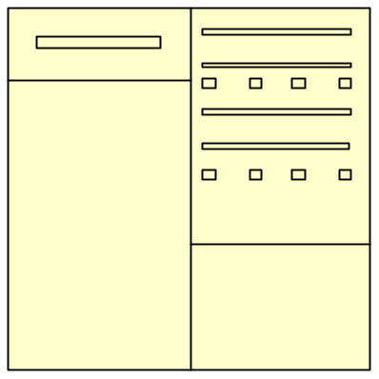

Digital Cash Payment
Trusted
Party
Conversion to
real money.
Bank
(A) Consumer purchases a cash value that can be used only once.
(C) Cash amount is verified and added to vendor account.
Vendor
(B) Customer choose product, sends ID or digital cash number.
Consumer

Slide 19
Data Quality
Integrity
  Errors in data entry.
  Missing data.
  Failure to make updates.
  Duplicate data
Multitasking/Concurrency
  Changes by two people at same time gives bad data.
  Unhandled concurrency
Volume
  Cost (disk, tape, time, backup)
  Errors harder to spot.
  Transmission costs over lines
  Difficulty of searching.
  System overload.
Summaries
  Too much detail.
  Hard to get detail.
Time
  Report and decision deadlines.
  Departments get data at different times.
  Sequencing problems.

Slide 20
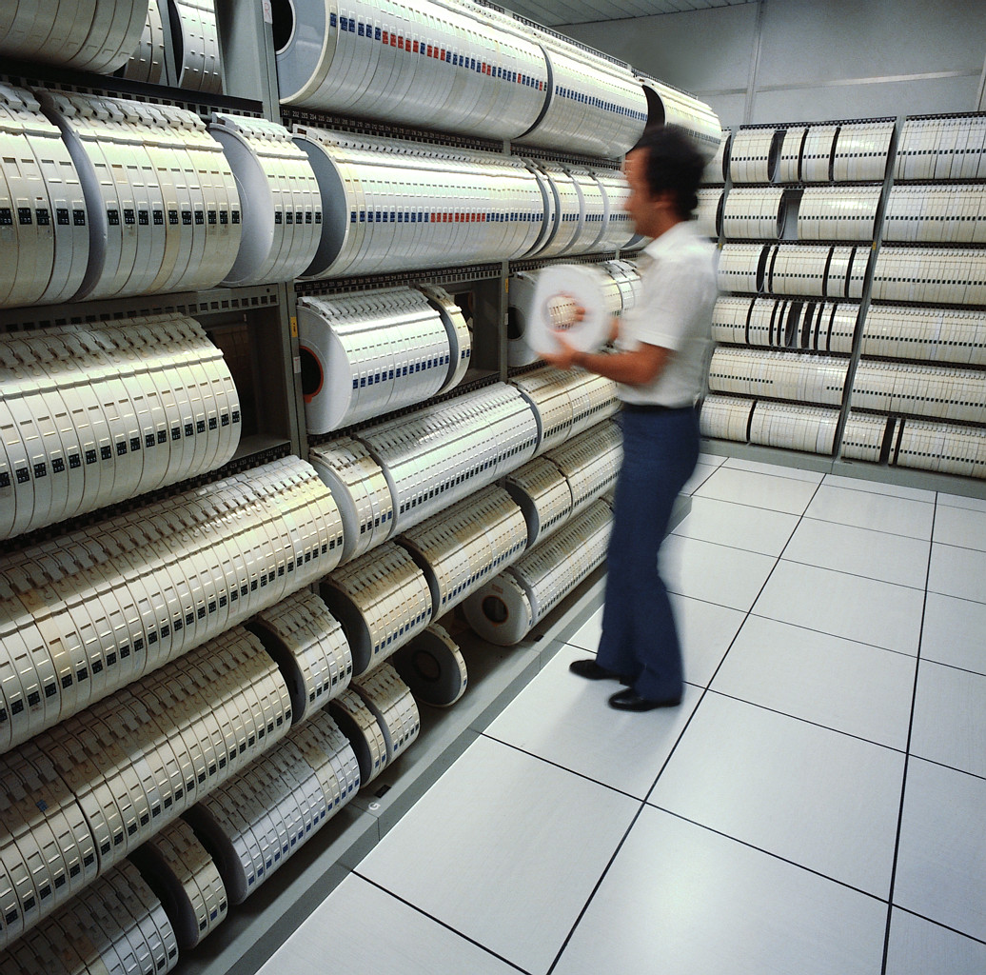
Multitasking and Concurrency
Data Integrity
Multitasking & concurrency
Data volume
Data summaries

Slide 21

Accounting
Financial data and reports
What do things really cost (cost accounting) ?
The accounting cycle
Inventory
Checks and balances
  Double-entry
  Separation of duties
  Audits

Slide 22
Accounting Software
General Ledger
  Sample chart of accounts
  Automatic posting
  Automatic entry of vendors
  Fiscal years
  Keep past data books open
  Post to prior years
  Allocate department expenses
Accounts Receivable
  Automatic early discounts
  Interest on late payments
  Multiple shipping addresses
  Sales tax
  Automatic reminder notices
  Automatic monthly fees
  Keep monthly details
Accounts payable
  Check reconciliation
  Automatic recurring entries
  Monitor payment discounts
  Select bills from screen
  Pay by item, not just total bill
General Features
  Printer support
  Use of preprinted forms
  Custom reports
  Custom queries
  Security controls
  Technical support costs
  Often legislation changes
  New year operations

Slide 23
Accounting
Management
Banks
and
Creditors
Loans & Notes
Planning Reports
Shareholders
Cash
Management,
Investments,
Foreign
Exchange
Management
Reports
Strategic
& Tactical
Planning
Shareholder
Reports
Capital Acct
Produce
Shareholder
Reports
Governments
Departments
& Employees
Planning
Data
Payroll &
Employee
Benefits
Produce
Management
Accounting
Reports
Equity
Tax Filings
Expenses
Tax
Filing &
Planning
Tax data
Payroll
Receivables
Inventory &
Assets
Sales Tax
Orders &
Accounts
Payable
Sales &
Accounts
Receivable
Payables
Inventory
Management,
& Fixed Asset
& Cost Acct.
Sales & Receivables
Customers
Purchases &
Payables
Inventory Changes
Inventory Changes
Suppliers
Supply &
In-process
Inventory
Product
Inventory

Slide 24
The Role of Accounting
Transaction Data
Purchases, Sales, Loans, and Investments
Inventory Control
Process and Controls
  Double-Entry Systems
  Separation of Duties
  Audits

Slide 25
Human Resources Management
Management
Compile
Merit
Evaluations
& Salary
Changes
Management Reports
Managers
Merit
Evaluations
Produce
Management
Employee
Reports
Government
Produce
Government
Reports
Merit &
Salary
Government
Reports
Salary
Employee
Summaries
Equal Employment Opportunity Data
Process
Payroll
Benefits
Vacation
Employee
Data
Employee Data Files
Screen
Jobs &
Applications
Employee
Data
Job &
Applicant
Data
Applicant Data
Employees
Sales Data &
Commission
Customers
Job
Applicants

